Slide 1
Deep learning – some practical concerns
Hung-Hsuan Chen
Many are adopted from Aurelien Geron’s book

Slide 2
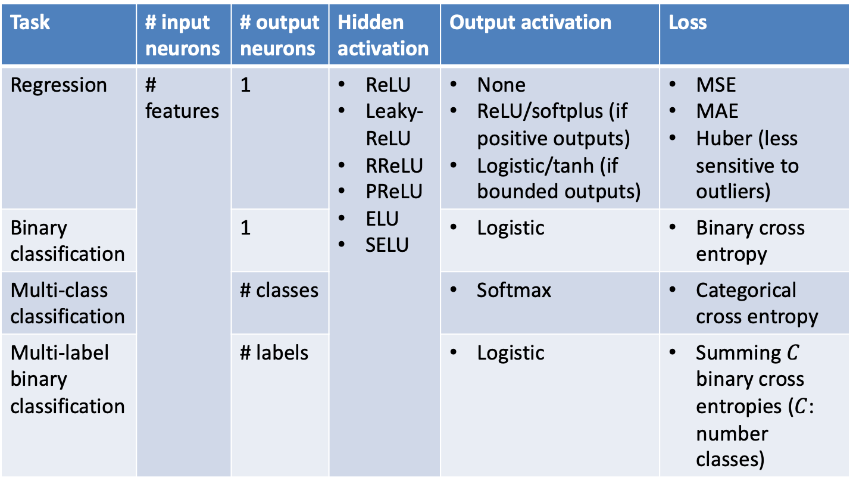
A summary of key component selections in DNN
Task | # input neurons | # output neurons | Hidden activation | Output activation | Loss
Regression | # features | 1 | ReLU Leaky-ReLU RReLU PReLU ELU SELU | None ReLU/softplus (if positive outputs) Logistic/tanh (if bounded outputs) | MSE MAE Huber (less sensitive to outliers)
Binary classification |  | 1 |  | Logistic | Binary cross entropy
Multi-class classification |  | # classes |  | Softmax | Categorical cross entropy
Multi-label binary classification |  | # labels |  | Logistic | Summing $C$ binary cross entropies ($C$: number classes)

Slide 3
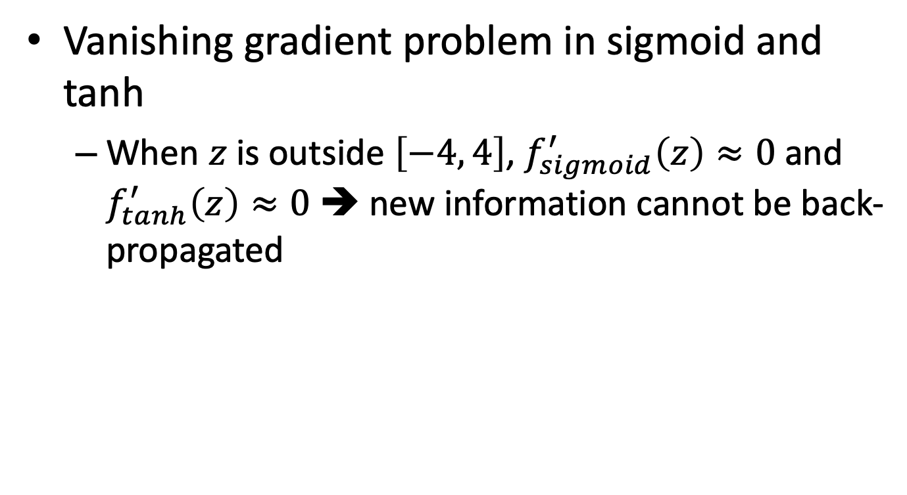
The vanishing gradient problem
Vanishing gradient problem in sigmoid and tanh
When $z$ is outside $\left[−4, 4\right]$, $f_{sigmoid}^{′}\left(z\right)≈0$ and $f_{tanh}^{′}\left(z\right)≈0$ ➔ new information cannot be back-propagated

Slide 4
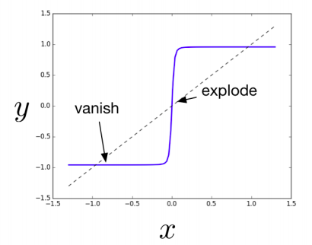
The exploding gradient problem

Slide 5
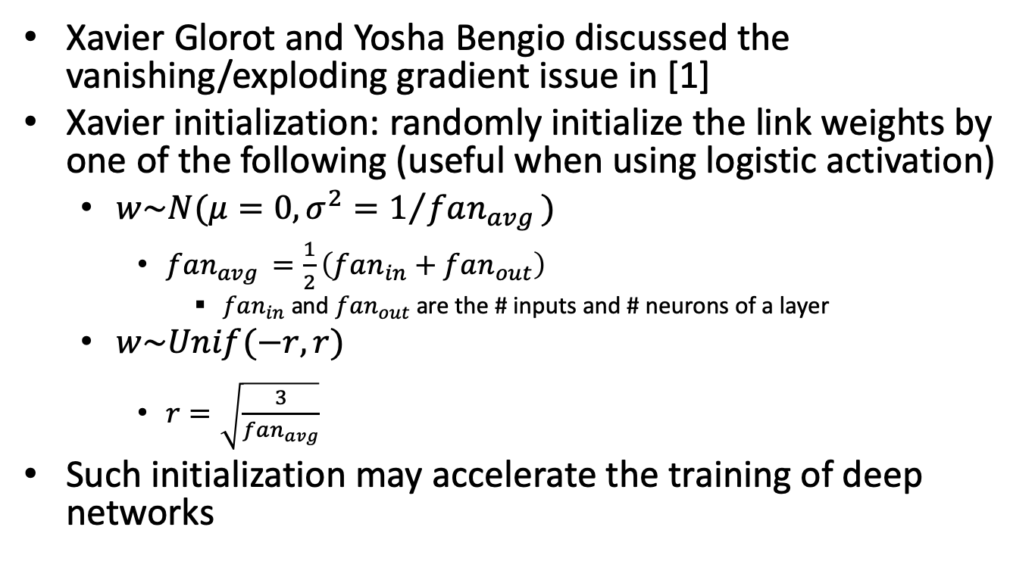
Xavier (a.k.a., Glorot) initialization
Xavier Glorot and Yosha Bengio discussed the vanishing/exploding gradient issue in [1]
Xavier initialization: randomly initialize the link weights by one of the following (useful when using logistic activation)
$w\sim N(μ=0, σ^{2}=1/{fan_{avg }})$
$fan_{avg }=\frac{1}{2}\left(fan_{in}+fan_{out}\right)$
$fan_{in}$ and $fan_{out}$ are the # inputs and # neurons of a layer
$w\sim Unif(−r,r)$
$r=\sqrt{\frac{3}{fan_{avg}}}$
Such initialization may accelerate the training of deep networks
[1] Xavier Glorot and Yosha Bengio, “Understanding the difficulty of training deep feedforward neural networks”, AISTAT 2001.

Slide 6
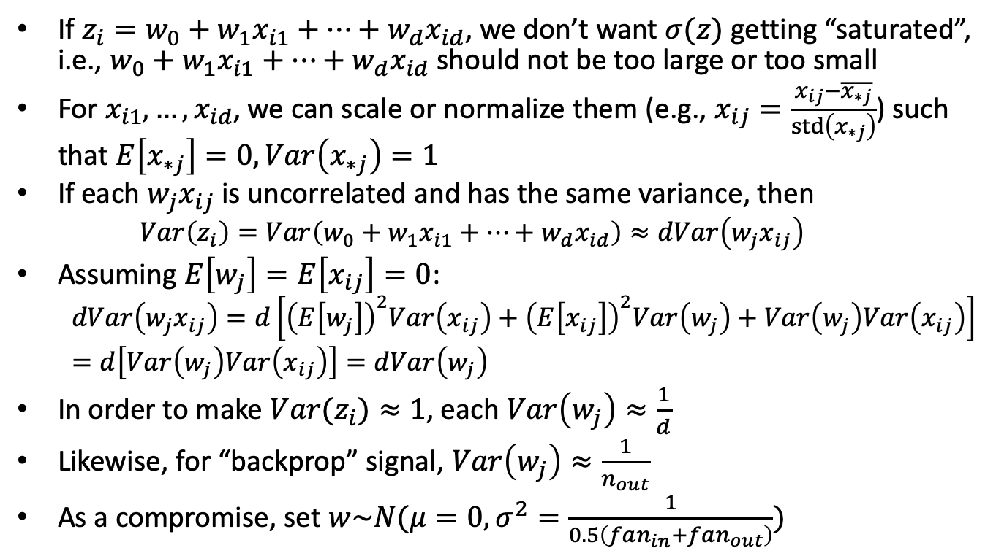
Intuition of why Xavier initializer works
If $z_{i}=w_{0}+w_{1}x_{i1}+…+w_{d}x_{id}$, we don’t want $σ(z)$ getting “saturated”, i.e., $w_{0}+w_{1}x_{i1}+…+w_{d}x_{id}$ should not be too large or too small
For $x_{i1},…,x_{id}$, we can scale or normalize them (e.g., $x_{ij}=\frac{x_{ij}−\overline{x_{∗j}}}{std\left(x_{∗j}\right)}$) such that $E\left[x_{∗j}\right]=0, Var\left(x_{∗j}\right)=1$
If each $w_{j}x_{ij}$ is uncorrelated and has the same variance, then
$$Var\left(z_{i}\right)=Var\left(w_{0}+w_{1}x_{i1}+…+w_{d}x_{id}\right)≈dVar\left(w_{j}x_{ij}\right)$$
Assuming $E\left[w_{j}\right]=E\left[x_{ij}\right]=0$:
$$dVar\left(w_{j}x_{ij}\right)=d\left[{\left(E\left[w_{j}\right]\right)}^{2}Var\left(x_{ij}\right)+{\left(E\left[x_{ij}\right]\right)}^{2}Var\left(w_{j}\right)+Var\left(w_{j}\right)Var\left(x_{ij}\right)\right]=d\left[Var\left(w_{j}\right)Var\left(x_{ij}\right)\right]=dVar\left(w_{j}\right)$$
In order to make ${Var(z}_{i})≈1$, each $Var\left(w_{j}\right)≈\frac{1}{d}$
Likewise, for “backprop” signal, $Var\left(w_{j}\right)≈\frac{1}{n_{out}}$
As a compromise, set $w\sim N(μ=0, σ^{2}=\frac{1}{0.5\left(fan_{in}+fan_{out}\right)})$

Slide 7
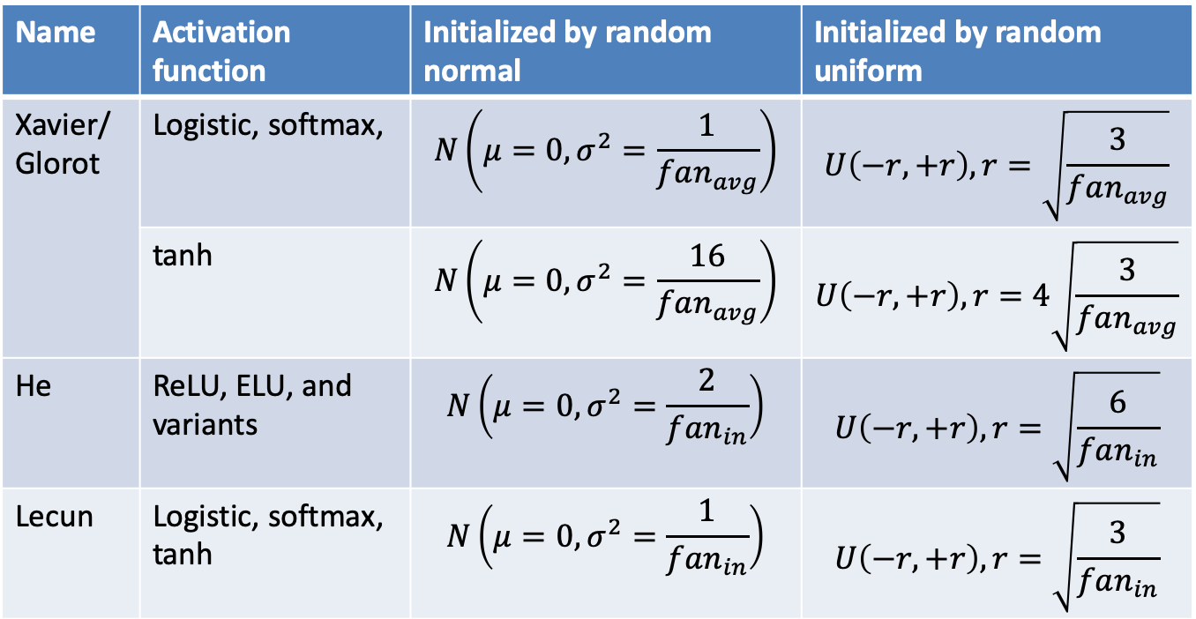
Famous weight initializers
Name | Activation function | Initialized by random normal | Initialized by random uniform
Xavier/Glorot | Logistic, softmax, | $$N\left(μ=0, σ^{2}=\frac{1}{fan_{avg}}\right)$$ | $$U\left(−r,+r\right), r=\sqrt{\frac{3}{fan_{avg}}}$$
 | tanh | $$N\left(μ=0, σ^{2}=\frac{16}{fan_{avg}}\right)$$ | $$U\left(−r,+r\right), r=4\sqrt{\frac{3}{fan_{avg}}}$$
He | ReLU, ELU, and variants | $$N\left(μ=0,σ^{2}=\frac{2}{fan_{in}}\right)$$ | $$U\left(−r,+r\right),r=\sqrt{\frac{6}{fan_{in}}}$$
Lecun | Logistic, softmax, tanh | $$N\left(μ=0,σ^{2}=\frac{1}{fan_{in}}\right)$$ | $$U\left(−r,+r\right), r=\sqrt{\frac{3}{fan_{in}}}$$

Slide 8
Non-saturating activation functions
Rectified Linear Unit (ReLU)
LeakyReLU
Randomlized leaky ReLU (RReLU)
Parametric Leaky ReLU (PReLU)
Exponential Linear Unit (ELU)
Scaled ELU (SELU)

Slide 9
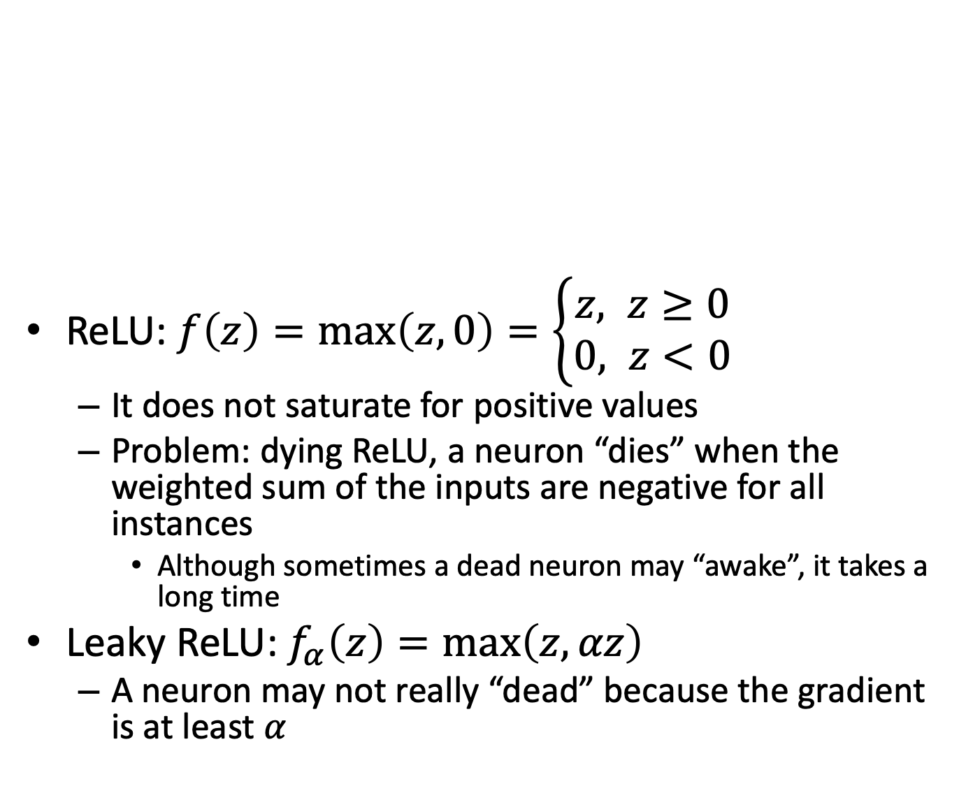
Non-saturating activation functions
ReLU: $f\left(z\right)=\max\left(z,0\right)=\left\{\begin{aligned}z, z≥0 \\ &0, z<0\end{aligned}\right.$
It does not saturate for positive values
Problem: dying ReLU, a neuron “dies” when the weighted sum of the inputs are negative for all instances
Although sometimes a dead neuron may “awake”, it takes a long time
Leaky ReLU: $f_{α}\left(z\right)=\max\left(z,αz\right)$
A neuron may not really “dead” because the gradient is at least $α$

Slide 10
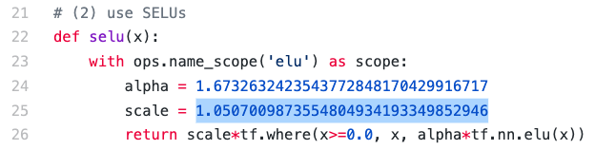
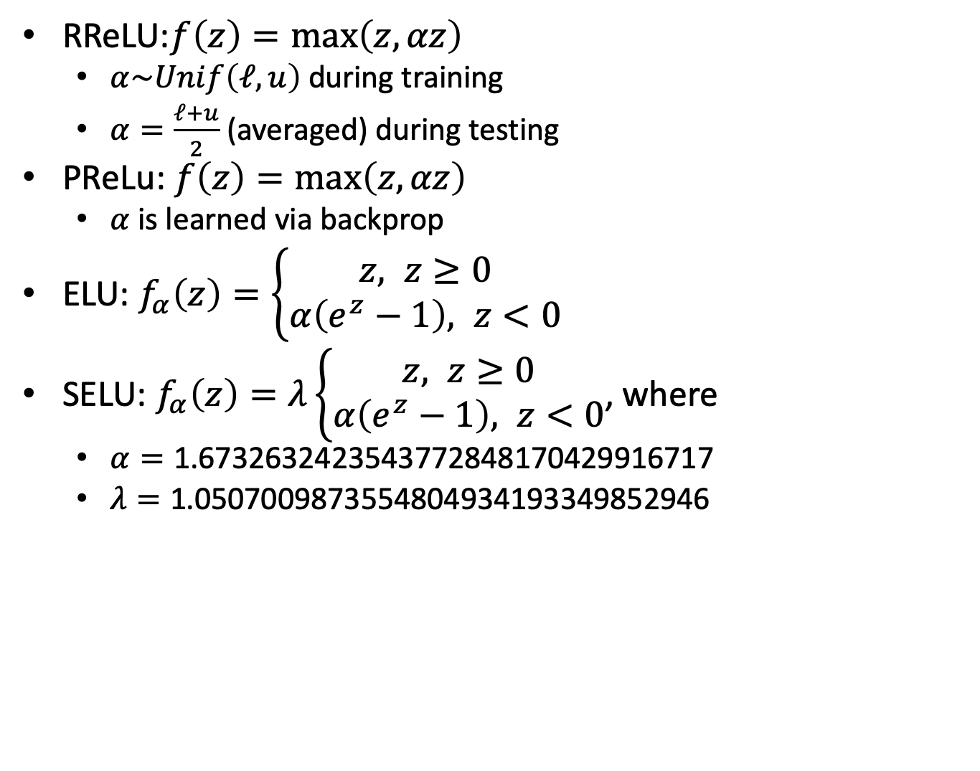
Non-saturating activation functions
RReLU:$f\left(z\right)=\max\left(z,αz\right)$
$α\sim Unif\left(ℓ,u\right)$ during training
$α=\frac{ℓ+u}{2}$ (averaged) during testing
PReLu: $f\left(z\right)=\max\left(z,αz\right)$
$α$ is learned via backprop
ELU: $f_{α}\left(z\right)=\left\{\begin{aligned}z, z≥0 \\ &α\left(e^{z}−1\right), z<0\end{aligned}\right.$
SELU: $f_{α}\left(z\right)=λ\left\{\begin{aligned}z, z≥0 \\ &α\left(e^{z}−1\right), z<0\end{aligned}\right.$, where
$α=\text{1.6732632423543772848170429916717}$
$λ=\text{1.0507009873554804934193349852946}$
Source of SELU:
https://github.com/bioinf-jku/SNNs/blob/master/selu.py
Ref of SELU paper: https://arxiv.org/pdf/1706.02515.pdf

Slide 11
When to use which activation function (in the hidden layer)?
Usually ReLU or its variants (e.g., SELU, ELU, leaky ReLU) are better choices rather than tanh or sigmoid
But may still need experiments to decide

Slide 12
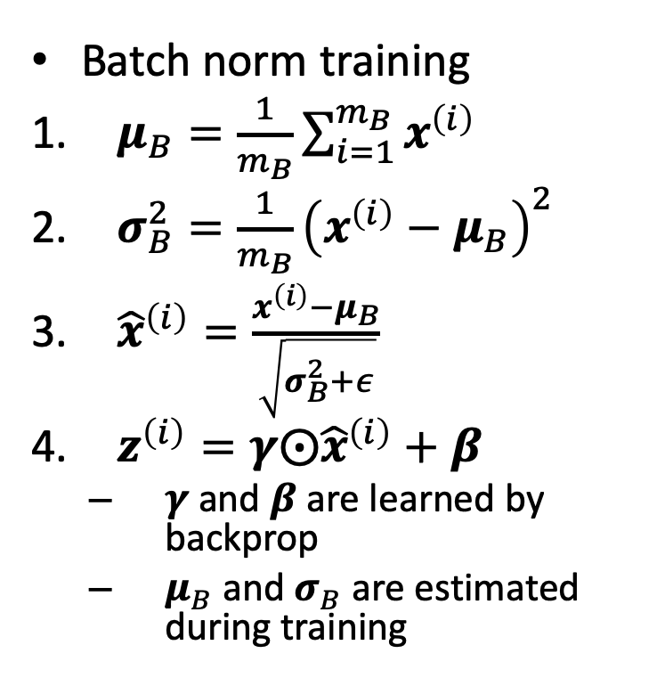
Batch normalization (1/2)
Adding operations before and after activation function (in hidden layer)
For every batch:
Zero-center and normalize inputs
Scale and shift (so that mean and standard deviation can beyond 0 and 1)
Batch norm training
$μ_{B}=\frac{1}{m_{B}}\sum_{i=1}^{m_{B}}{x^{\left(i\right)}}$
$σ_{B}^{2}=\frac{1}{m_{B}}{\left(x^{\left(i\right)}−μ_{B}\right)}^{2}$
${\hat{x}}^{\left(i\right)}=\frac{x^{\left(i\right)}−μ_{B}}{\sqrt{σ_{B}^{2}+ε}}$
$z^{\left(i\right)}=γ⨀{\hat{x}}^{\left(i\right)}+β$
$γ$and $β$are learned by backprop
$μ_{B}$ and $σ_{B}$ are estimated during training

Slide 13
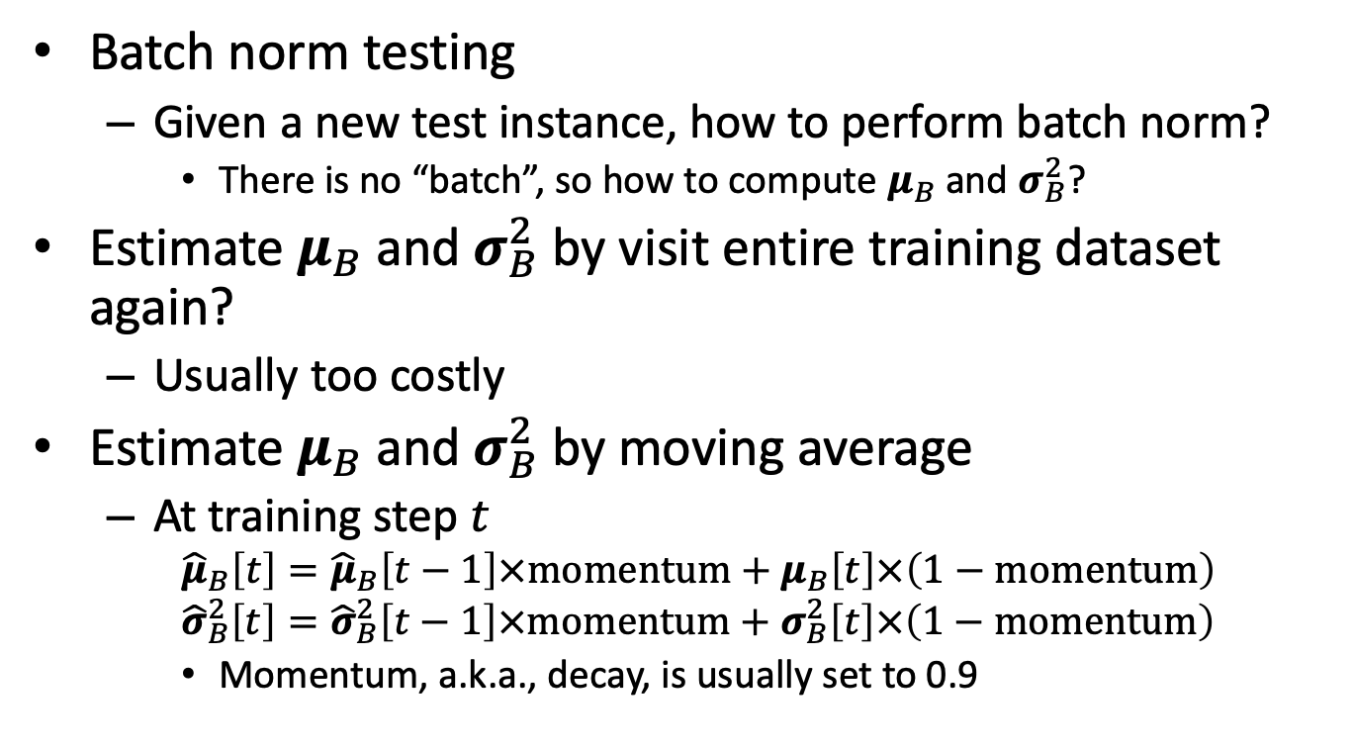
Batch normalization (2/2)
Batch norm testing
Given a new test instance, how to perform batch norm?
There is no “batch”, so how to compute $μ_{B}$ and $σ_{B}^{2}$?
Estimate $μ_{B}$ and $σ_{B}^{2}$ by visit entire training dataset again?
Usually too costly
Estimate $μ_{B}$ and $σ_{B}^{2}$ by moving average
At training step $t$
$${\hat{μ}}_{B}\left[t\right]={\hat{μ}}_{B}\left[t−1\right]×momentum+μ_{B}\left[t\right]×\left(1−momentum\right)$$
$${\hat{σ}}_{B}^{2}\left[t\right]={\hat{σ}}_{B}^{2}\left[t−1\right]×momentum+σ_{B}^{2}\left[t\right]×\left(1−momentum\right)$$
Momentum, a.k.a., decay, is usually set to 0.9

Slide 14
Gradient clipping
For RNN, it could be tricky to apply Batch norm
Manually clip the gradient when it is too large or too small
Example: set upper bound to 1, lower bound to -1
If gradient is larger than 1, output 1
If gradient is smaller than -1, output -1

Slide 15
Transfer learning via pretrained layers

Slide 16
Layer-wise pretraining
Used to be a popular method in ~2010
May still be useful when # training instances is limited

Slide 17
Various optimizers
SGD
Momentum
Nesterov Accelerated Gradient
AdaGrad
RMSProp
Adam
Nadam

Slide 18
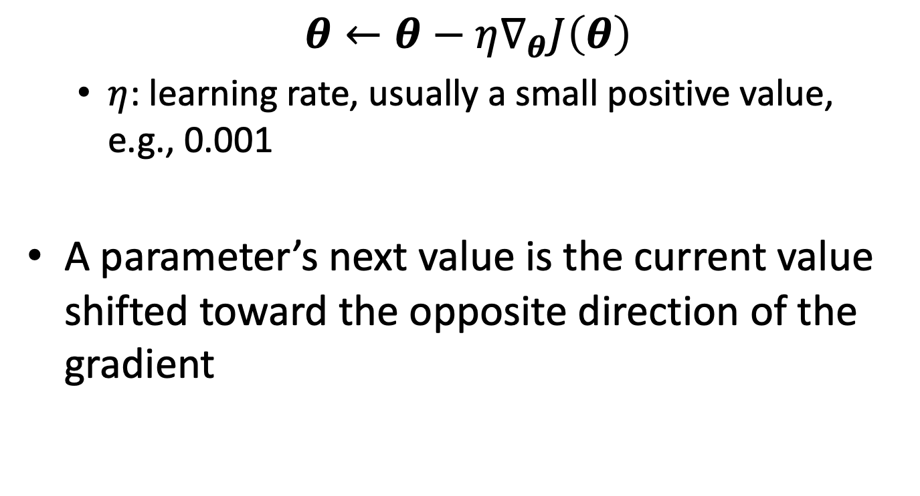
SGD
$$θ←θ−η∇_{θ}J\left(θ\right)$$
$η$: learning rate, usually a small positive value, e.g., 0.001
A parameter’s next value is the current value shifted toward the opposite direction of the gradient

Slide 19
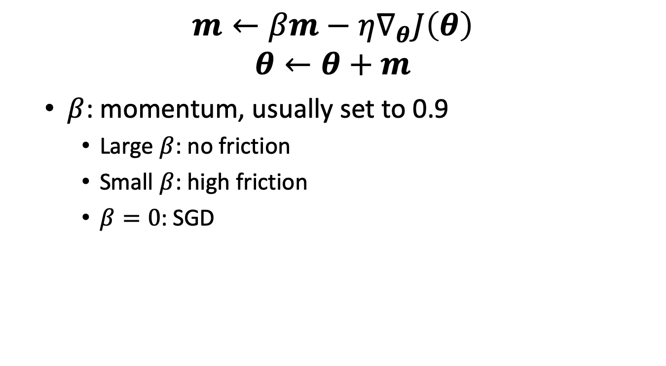
Momentum
$$m←βm−η∇_{θ}J\left(θ\right)$$
$$θ←θ+m$$
$β$: momentum, usually set to 0.9
Large $β$: no friction
Small $β$: high friction
$β=0$: SGD

Slide 20
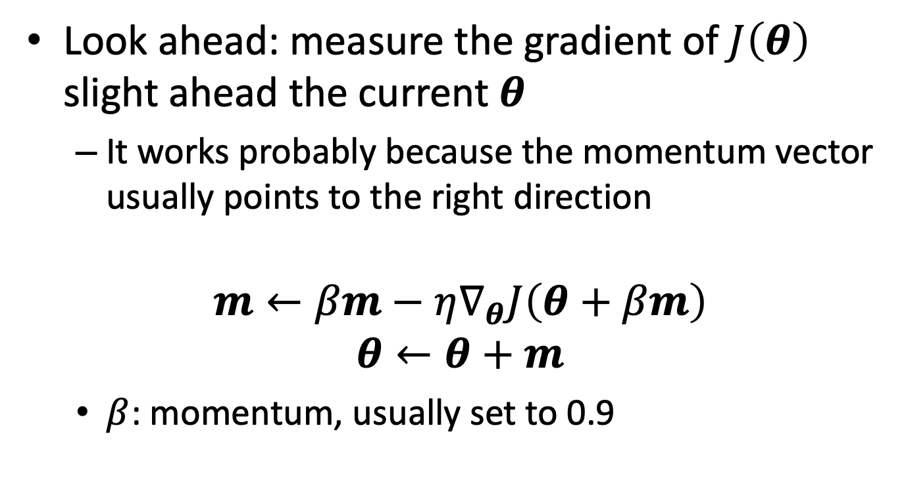
Nesterov Accelerated Gradient (NAG)
Look ahead: measure the gradient of $J\left(θ\right)$ slight ahead the current $θ$
It works probably because the momentum vector usually points to the right direction
$$m←βm−η∇_{θ}J\left(θ+βm\right)$$
$$θ←θ+m$$
$β$: momentum, usually set to 0.9

Slide 21
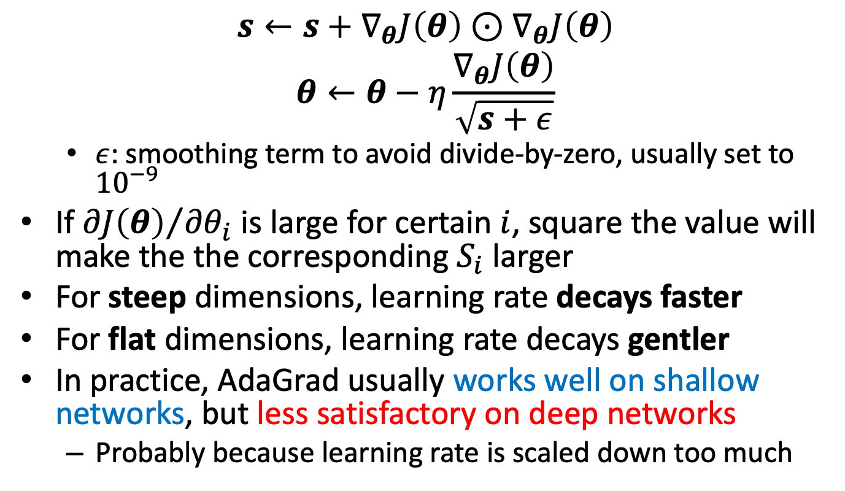
AdaGrad (1/2)
$$s←s+∇_{θ}J\left(θ\right)⊙∇_{θ}J\left(θ\right)$$
$$θ←θ−η\frac{∇_{θ}J\left(θ\right)}{\sqrt{s+ε}}$$
$ε$: smoothing term to avoid divide-by-zero, usually set to ${10}^{−9}$
If ${∂J\left(θ\right)}/{{∂θ}_{i}}$ is large for certain $i$, square the value will make the the corresponding $S_{i}$ larger
For steep dimensions, learning rate decays faster
For flat dimensions, learning rate decays gentler
In practice, AdaGrad usually works well on shallow networks, but less satisfactory on deep networks
Probably because learning rate is scaled down too much

Slide 22
AdaGrad (2/2)

Slide 23
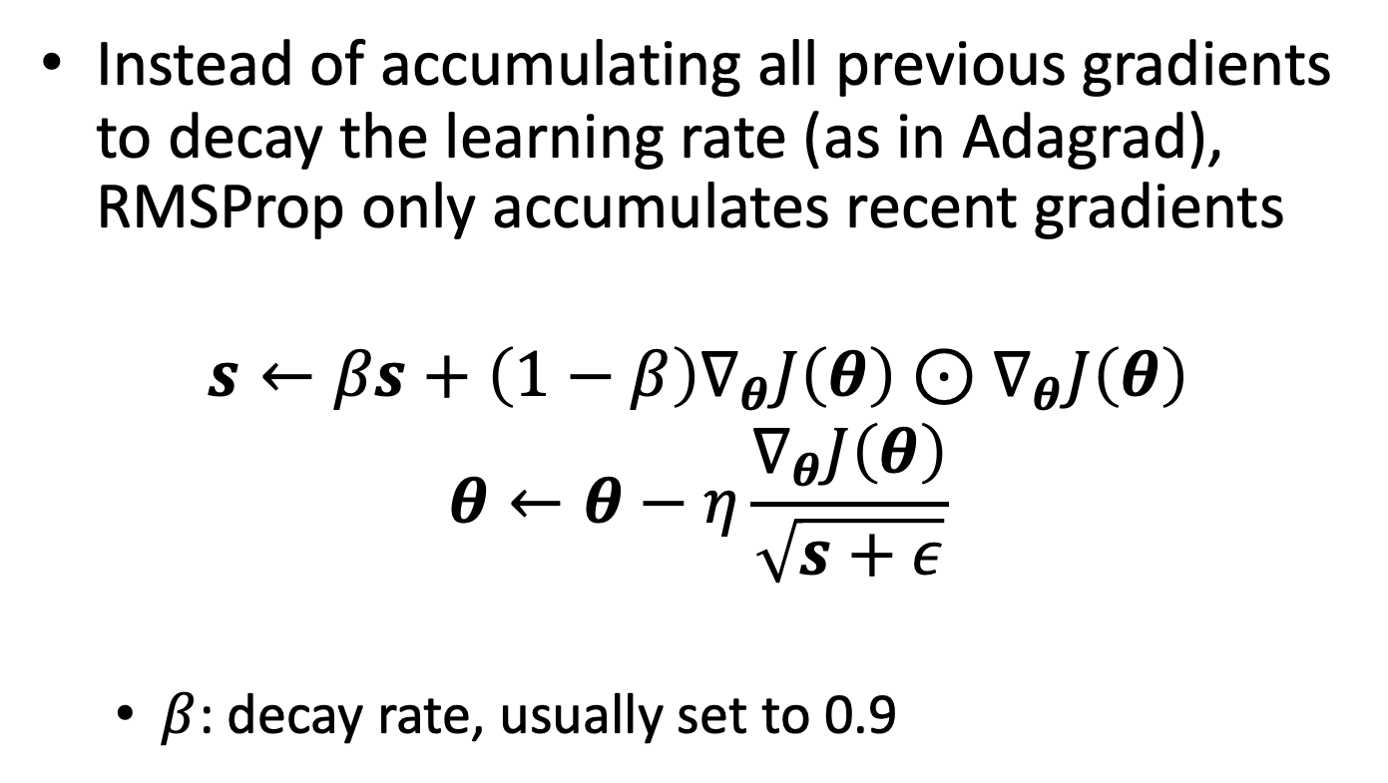
RMSProp
Instead of accumulating all previous gradients to decay the learning rate (as in Adagrad), RMSProp only accumulates recent gradients
$$s←βs+\left(1−β\right)∇_{θ}J\left(θ\right)⊙∇_{θ}J\left(θ\right)$$
$$θ←θ−η\frac{∇_{θ}J\left(θ\right)}{\sqrt{s+ε}}$$
$β$: decay rate, usually set to 0.9

Slide 24
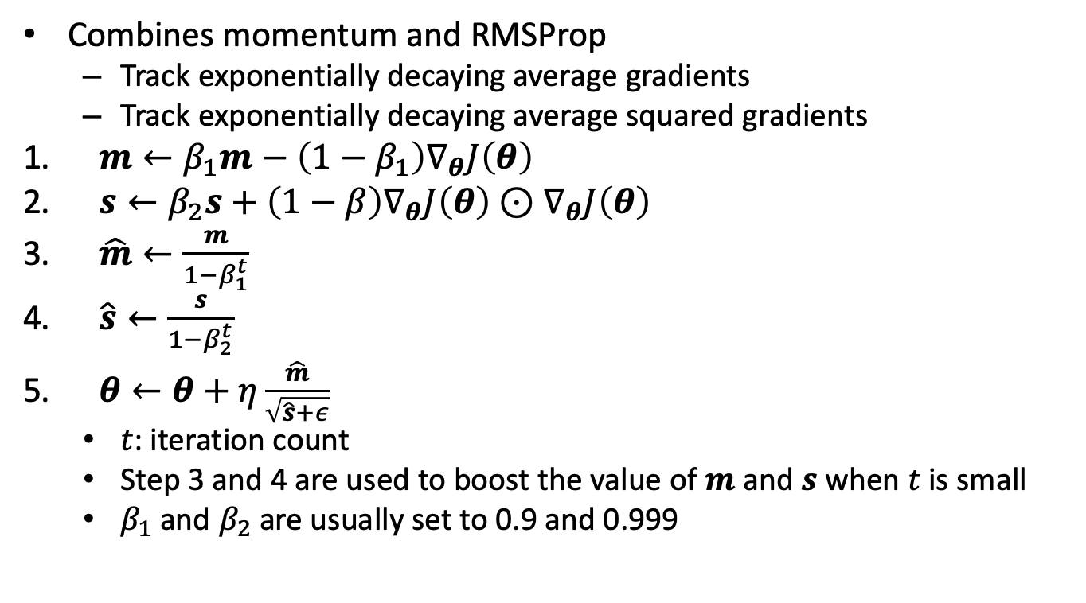
Adaptive moment estimation (Adam)
Combines momentum and RMSProp
Track exponentially decaying average gradients
Track exponentially decaying average squared gradients
$m←β_{1}m−\left(1−β_{1}\right)∇_{θ}J\left(θ\right)$
$s←β_{2}s+\left(1−β\right)∇_{θ}J\left(θ\right)⊙∇_{θ}J\left(θ\right)$
$\hat{m}←\frac{m}{1−β_{1}^{t}}$
$\hat{s}←\frac{s}{1−β_{2}^{t}}$
$θ←θ+η\frac{\hat{m}}{\sqrt{\hat{s}+ε}}$
$t$: iteration count
Step 3 and 4 are used to boost the value of $m$ and $s$ when $t$ is small
$β_{1}$ and $β_{2}$ are usually set to 0.9 and 0.999

Slide 25
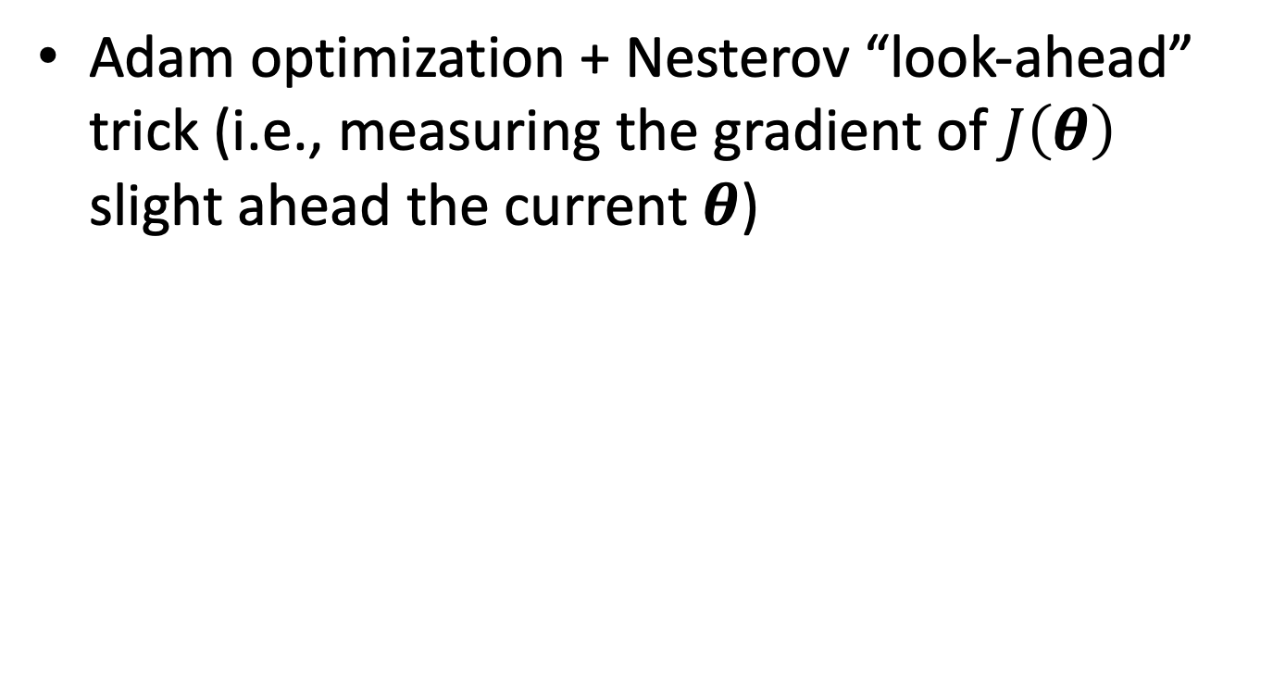
NADAM
Adam optimization + Nesterov “look-ahead” trick (i.e., measuring the gradient of $J\left(θ\right)$ slight ahead the current $θ$)

Slide 26
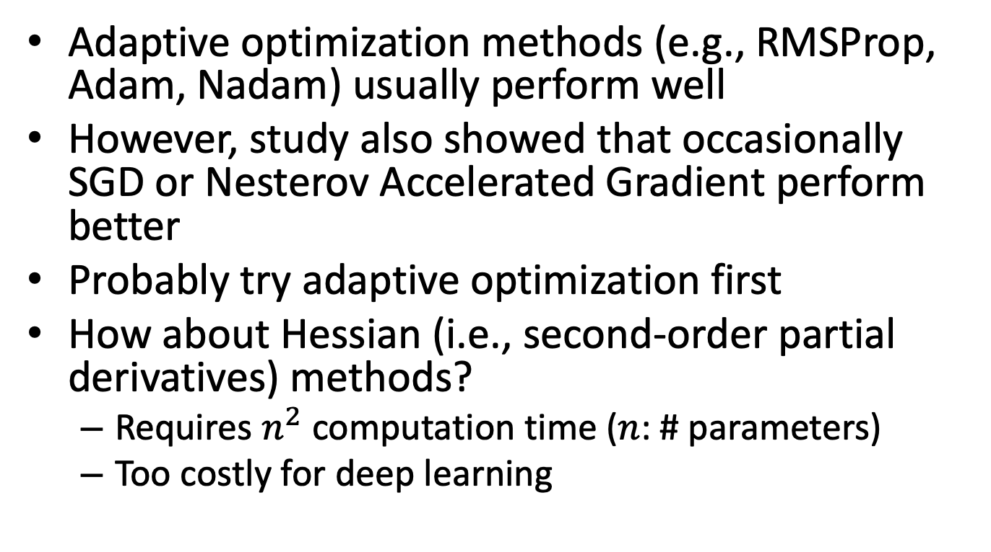
Summary of optimizer selection
Adaptive optimization methods (e.g., RMSProp, Adam, Nadam) usually perform well
However, study also showed that occasionally SGD or Nesterov Accelerated Gradient perform better
Probably try adaptive optimization first
How about Hessian (i.e., second-order partial derivatives) methods?
Requires $n^{2}$ computation time ($n$: # parameters)
Too costly for deep learning

Slide 27
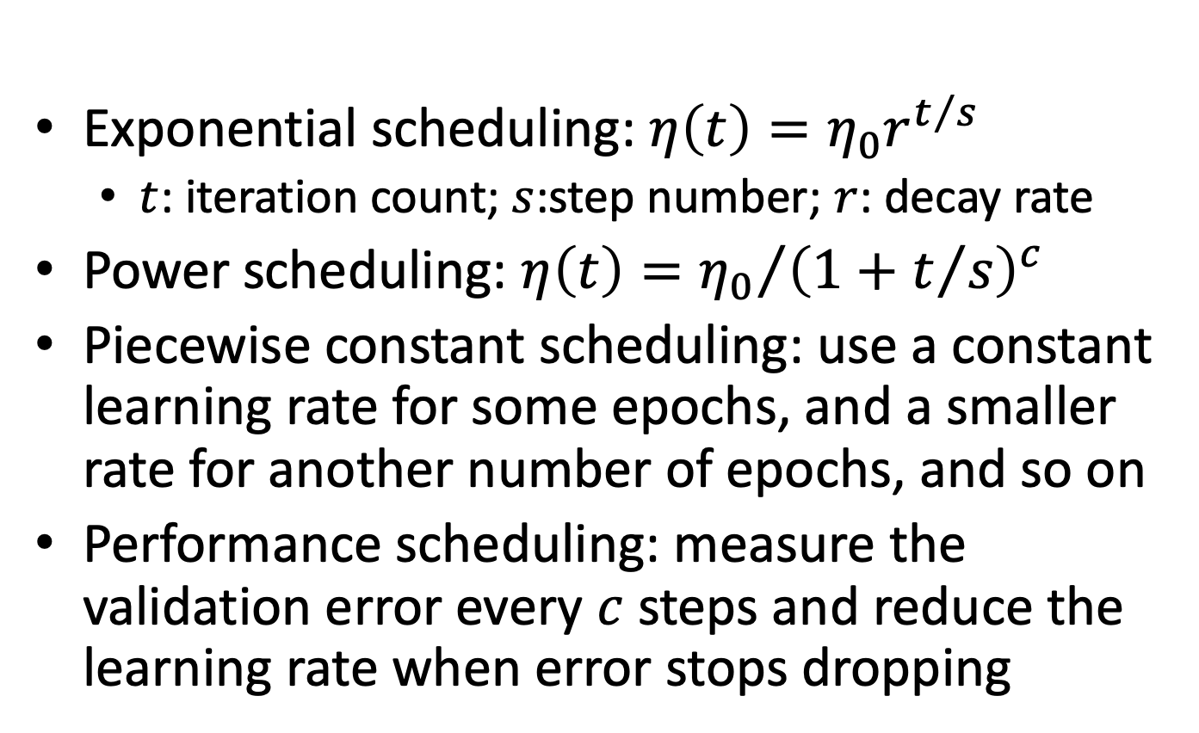
Learning rate scheduling
Exponential scheduling: $η\left(t\right)=η_{0}r^{t/s}$
$t$: iteration count; $s$:step number; $r$: decay rate
Power scheduling: $η\left(t\right)={η_{0}}/{{\left(1+t/s\right)}^{c}}$
Piecewise constant scheduling: use a constant learning rate for some epochs, and a smaller rate for another number of epochs, and so on
Performance scheduling: measure the validation error every $c$ steps and reduce the learning rate when error stops dropping

Slide 28
Regularization techniques
Weight penalty
Data augmentation
Early stopping
Dropout

Slide 29
Regularization – weight penalty
Similar to what we’ve used in linear regression and logistic regression
L2-norm
Penalize the squared values of the weights
Tend to shrink large weights to smaller values
L1-norm
Penalize the absolute values of the weights
Tend to shrink some weights to zero; while other weights may still be large
A combination of both (e.g., elastic-net)

Slide 30
Regularization – data augmentation
More data leads to less variance
Less likely to overfitting
Collect more data
Add synthetic data
E.g., to increase the synthetic training data for object recognition from images, popular techniques include
Rotate images
Scale image
Translating a few pixels
Injecting random negatives pictures
Seems no principle way to generate synthetic data across different domains

Slide 31
Regularization – early stopping
Training the model based on training data
Validate the performance of the current model based on validation data
Assume that validation data are representative of future (unseen) data
Once the validation performance starts get worse, stop training
Although training performance continues improving, the model may starts learning the “noise” in the training data

Slide 32
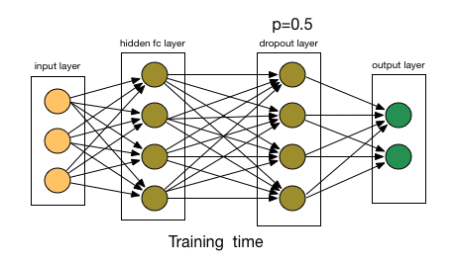
Regularization – dropout
Randomly remove some nodes and their incoming and outgoing connections
If randomly remove certain neurons the model can still learn something, the model is probably more robust and more resilient to noise

Slide 33
Summary
When networks become “deep”, simple SGD may be problematic, because of vanishing and exploding gradient
Many techniques were proposed to (partially) solve the problem to accelerate learning
Weight initialization
Activation function design
Optimizer design
…

Slide 34
Quiz
Compare ReLU and sigmoid activations
It is fine to initialize all weights to the same value, as long as we use some standard normalization (e.g., Xavier or He initialization)

